Slide 1
Agent-Based Modeling: Graphical Interface Storyboard
John Knox
Fall 2019

Slide 2
Environment Setup
New Project - > Save project name
Enter W, H, Logic
Notes:
Logic: boundary condition, loop across or reflect

Slide 3
Agent Setup
+
Add agent to environment

Slide 4
Agent Setup
+
Enter Agent Name, Icon Color

Slide 5
Agent Setup
This example: 2 agents
+
Enter Agent Name, Icon Color

Slide 6


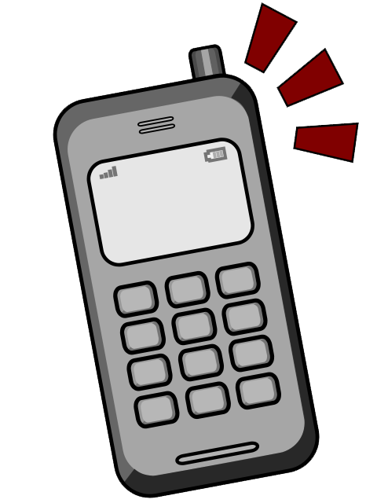

Agent Attributes
All agent (X,Y) and Direction are initially assigned randomly
Attributes
+
Move (direction)
Health
Comms
Agent Type
(X,Y)

Slide 7



Agent Trigger Zones
Triggers
+
Touch
Sight
Death
CUSTOM

Slide 8
Visualizing Trigger Zones
Relative Action Screen
+
Touch
Sight
Death
CUSTOM

Slide 9
Agent-Trigger Relationships
Sight
Sight
None
Direction towards
Direction away
None
Death
Death
None
None
Heath
None

